Slide 1
AI Core Project Part 1
The Scraper

Slide 2
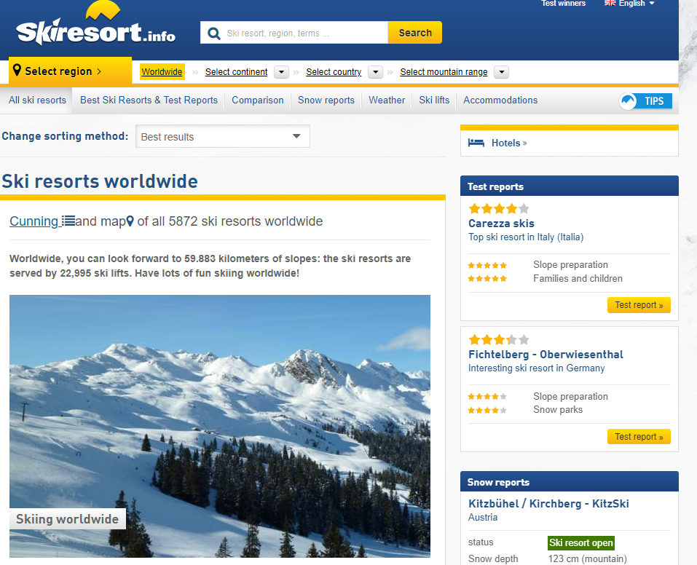
Data – Ski Resort Information
Data from skiresort.info
Rich database with nearly 6000 ski resorts / pistes etc. from all over the world
A lot of summary information with the potential for more detailed info

Slide 3
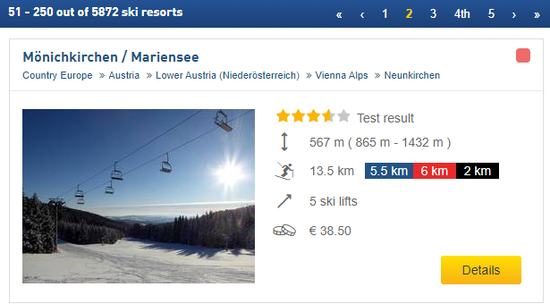
Data – Content
Each resort has summary table:
Name
Location (Continent, Country, Region etc.)
Rating from 5
Elevation Change
Max/Min Altitude
Ski piste lengths and breakdown of difficulty level
Number of ski lifts
Cost
Image
Link to further info

Slide 4
Data – What does it look like?

Slide 5
Data – What’s it for?
ML ideas:
Predict the cost from the other data, e.g. location, piste length, lifts
Future ideas (Might require getting extra info from the individual resort pages):
Predict season length based on altitude
Populate information using just the piste map (Would use CNN)
Website/app ideas:
Where to ski recommendation tool

Slide 6
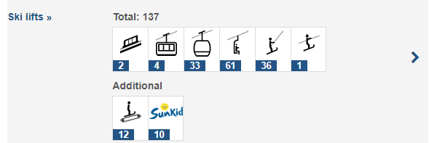
Data – More detailed info
Additional ski routes
Types of ski lifts
Costs for other age groups
General season
Opening times
Nearby towns/villages

